Slide 1
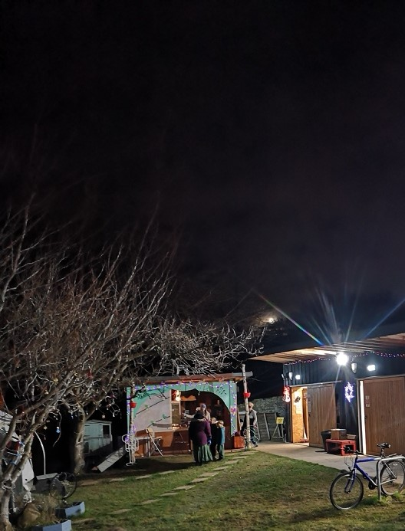
Bridgend Farmhouse survey community findings

Slide 2
Key facts:
· The survey represents the views of a total of 398 people in the EH16 and EH17 area.
It could be completed as an individual or on behalf of a household.
54% of all responses came from the EH16 area.
38% of all responses came from 30 -44 age group
24% of all responses have a health condition
31% would identify themselves or household as having mental health issues
75% of the people had not visited Bridgend

Slide 3
Bridgend Farmhouse – people who don’t visit

Slide 4
Promotion of Bridgend
Promotion of Bridgend Farmhouse
Use external wall space to make large signs – raise awareness to passing traffic
Make online material that makes BF welcoming.
Communication methods: word of mouth and social media (all) very popular. Emails not so effective , texting
a position of facilitator to welcome people – big bell to alert office of visitors who can welcome people
Have café running at set times time with a paid member of staff –regular hours.
More could be made of the café, and bring money in – affordable food needed
Rebrand Bridgend as a community hub
Discount for locals in café and activities
Raise awareness
EH16 and 17 is a very large area – a lot of community issues over a large area.
Need to find a niche and work out core strengths and where are other people doing things.
Make sure there are no overlaps and work more in partnership.
Focus on quality rather than quantity
Create a timetable of events for families
narrow our geographical or economic focus
Make a food product by BF
Advertise specific volunteer roles
Student placements

Slide 5
Mental health

Slide 6
Addressing mental health/wellbeing
Reach out to people who are isolated – started this with cream teas and postcard project
Social projects – zoom singing/arts
Look into offering I.T. support so people can access zoom etc
Walking and exercise groups –(park run/yoga/tai chi)
Mindfulness/meditation
Buddy groups ( neighbourly)
Arts and crafts with a purpose
Gardening spaces and classes
Community meals
Young mums help

Slide 7
Covid 19 Response (and beyond)
Bike repairs, maintenance, walking group – a need to promote and raise awareness.
Timing of groups is important –multiple times e.g. morning and evening so working people can join
Skills development work and employability has come up
IT activities for people who don’t have equipment/skills.

Slide 8
Ideas for community development projects
Children, young people and play
Parent and child yoga and mindfulness.
Youth café – with different activities
food
Nutrition classes on a budget
Café – more structured hours, paid staff, cards which let people know it is run by volunteers
Make a Bridgend product which can be sold to markets etc to make people aware of BF
Affordable Farmers market
Grow your own veg classes
Healthy eating groups
Other
Have an App/Twitter/online directory so residents can engage with what is going on in the community
Older people
More for older people that is not bingo or similar.
Social and groups that look at topics such as history, women’s
Intergenerational groups
General community
New mums group, coffee mornings etc
Tool Library
Hacker/ maker space
Time bank
litter picking squads for greenspace
Health and wellbeing and sports
Evening exercise for working people
An art club/ programme of art workshops and classes.
Film screenings.
Trauma Release Exercises - therapy
Geology/foraging walks

Slide 9
Skills sharing
Would like to learn
Hacking/making
DIY
Gaelic lessons, Scottish History
Maintaining/repair own bicycle
Garment making
Accessible training short courses in area of numeracy and literacy
Could share
Nutrition and in yoga
Arabic bellydance for adultS
Storytelling and literacy
Graphic design, Adobe
Social groupS
CV development and basic IT skills, facilitation and group work
Skill sharing directory

Slide 10
Bridgend Farmhouse
I'd love to take part in more activities and events when you get back to hosting them. Also being able to use your cafe more at weekends. Keep up the good work.
Bridgend Farmhouse is fabulous
Not really except still missing you all and really would like to come back and work with you again soon
Although I had not heard about Bridgend Farmhouse I commend your efforts to improve life for the community. Shall find out more.
I think what you are doing is great.
Keep up the good work!
Well done, and thank you
Always glad to hear from Bridgend Farmhouse 😊
Thank you for all Bridgend do for the community
I am so glad that we came to the farmhouse this October break and we will definitely look out for other activities that we could be a part of
Well done to you guys for actually caring about this area and trying to keep people involved and engaged Well done for the work you undertook during lock down it was tremendous

Slide 11
Summary
Some sort of big publicity push is needed – rebrand as a community hub?
Targeting: Who are Bridgend - for a specific community, or the entire community? What is Bridgend, who is it for and what are we trying to to achieve – to refocus and get into gear for when they do re-open. Pick a few things to do really well and go from there
The café is a golden resource that isn’t being used as well as it could be . It could have set times and perhaps be manned by someone who is paid and who supports volunteers and vulnerable adults.
Social enterprise idea (there is a clear need for locally available healthy food): Produce something that is niche to Bridgend – e.g. flap jack – could have it in other venues and shops. There is lots of room in the catering kitchen – find a product to make – volunteers then always have something to do – that could be sold in the café and sent out to other places – a promotion –E.g. infused oils, flapjack. Volunteers could make, promote and run the business. This would be a longer term project that would build the organisation and help people develop new skills. Outreach

Slide 12
Summary
•We don’t have a farmers market– could have one where we have our own stall and others there too.
• A skills exchange directory
Address mental health and wellness – exercise, therapy, mindfulness, arts,singing,nature
• List of volunteer activities that is accessible/regularly updated
• New mums group could be a good thing for BF – Inch has one but is a long way away
•More family activities to draw people in
New proposed activities to consider – are there other local organisations doing similar? Do they meet the needs of local community?

